Slide 1


Universidad de las Fuerzas Armadas "ESPE"
Group 3
Condominium Management System
Software Engineering
Team members: Klever Jami,
Gabriel Manosalvas,
José Leiton
Alexander Maza,
Fecha: 09/12/2024

Slide 2
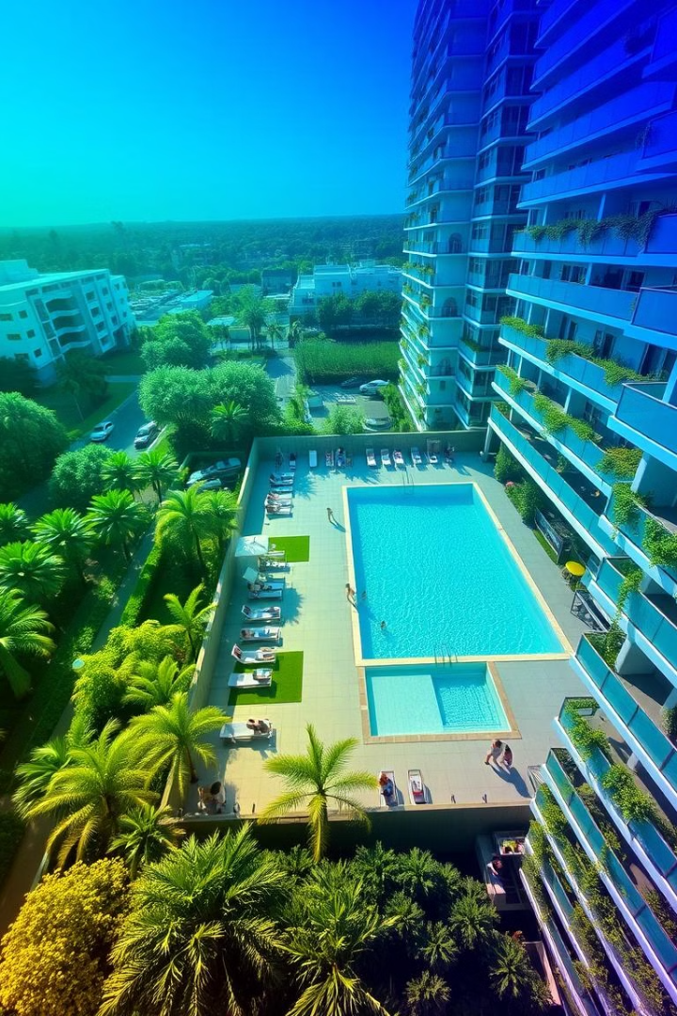
Condominium Management System: A Comprehensive Solution
This presentation outlines the design and functionalities of a condominium management system. We will delve into the system's architecture, key classes, functionalities, and future enhancements. Our goal is to provide a user-friendly and efficient solution for managing various aspects of condominium operations.
KJ

Slide 3
Project Objectives: Streamlining Condominium Management
Comprehensive Data Management
CRUD-Based Data Management
The system centralizes essential condominium data (resident info, vehicles, payments, utilities, reservations), streamlining operations and eliminating disparate systems.
A robust CRUD framework allows administrators to easily add, modify, and delete resident, vehicle, payment, and other key data.

Slide 4

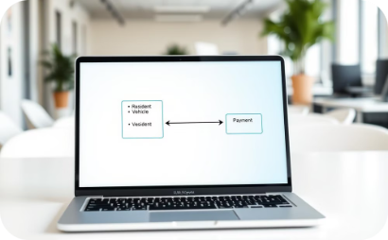
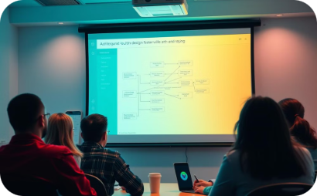



Condominium Management System Development
1. Requirements Definition
2. Analysis
3. Design
4. Implementation
Gathering condominium needs.
Identification of key classes and relationships.
Creation of a complete UML diagram.
Java development of the system.
5. Testing
6. Maintenance
Unit and integration testing.
Continuous updates and improvements.

Slide 5
Condominium Management Platform: Requirements Overview
System Goal
Resident Features
Administrator Features
To provide a comprehensive platform for managing condominiums, offering convenient and efficient tools for both residents and administrators.
Bill payments
Resident, vehicle, reservation, and payment management
Common area reservations
Access management
Access control
Personal information access
Payment and bill status monitoring

Slide 6
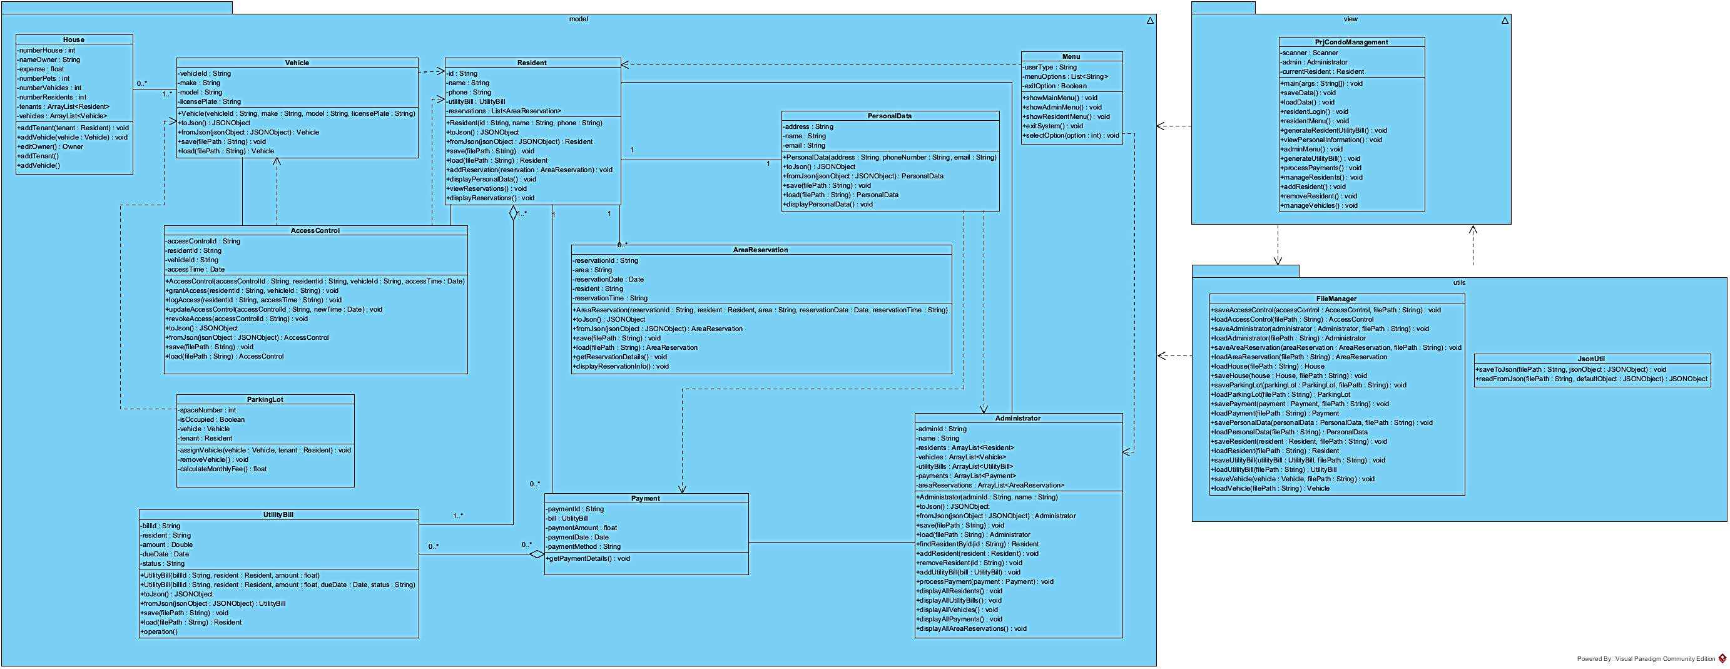
UML System Diagram UML Diagram Explanation:

Slide 7

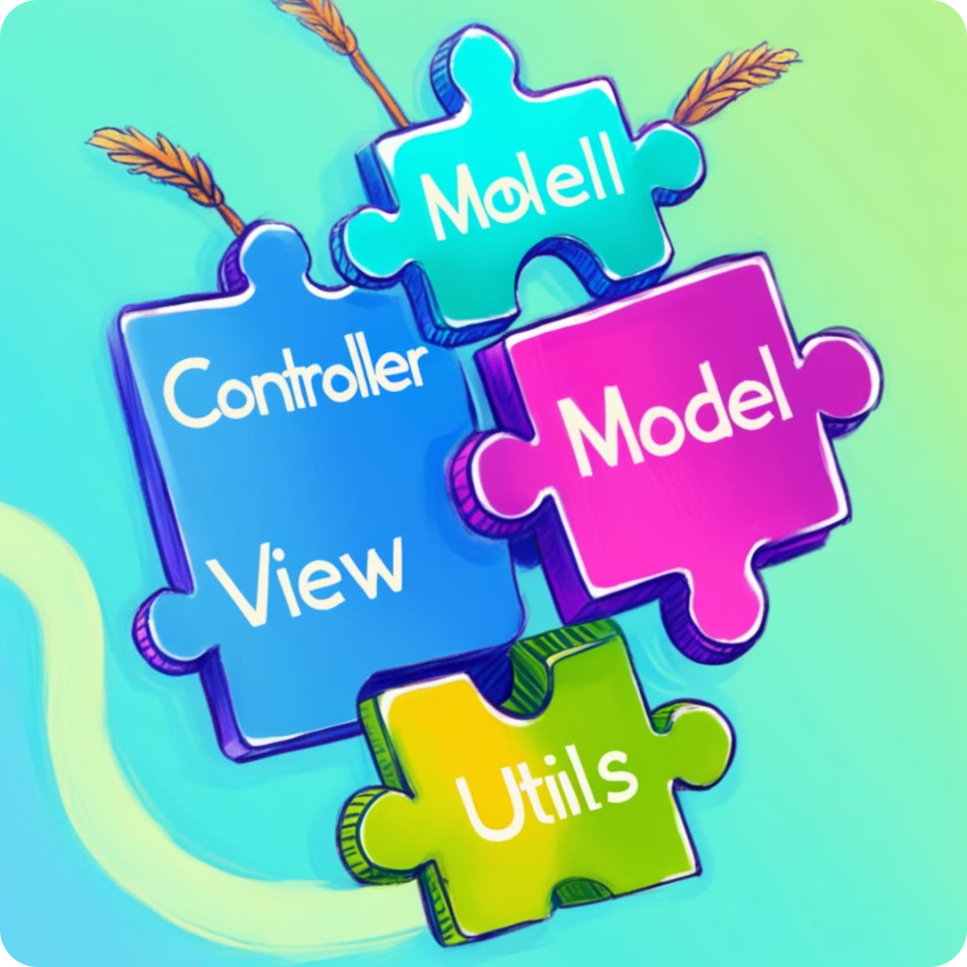
System Architecture: A Modular Design
Model
View
The Model package contains core entity classes (Resident, Vehicle, Payment, etc.), defining data structure and behavior.
The View package's Menu class provides the user interface for system interaction and data management.
Utils
The Utils package's FileManager handles efficient JSON data persistence and retrieval.

Slide 8
Classes
Resident
Vehicle
Represents residents with attributes like ID, name, and phone number. Manages resident details, including vehicle registration and billing information.
Represents residents' vehicles with attributes like ID, make, model, and plate number. Facilitates associating vehicles with residents and managing parking assignments.
Payment
Utility Bill
Manages payments made by residents, including payment ID, amount, date, and method. Tracks payment history and invoice reconciliation.
Represents service invoices issued to residents, including invoice ID, resident, amount, due date, and payment status. Enables efficient invoice generation and tracking.

Slide 9
Classes
Access Control
Parking Lot
Manages the access of residents and vehicles to the condominium. Attributes: accessControlId, residentId, vehicleId, accessTime. Methods: Grant, register, and revoke access to condominium areas.
Manages the parking spaces of the condominium. Attributes: spaceNumber, isOccupied, vehicle, tenant. Methods: Assign or release parking spaces.
Area Reservation
House
Manages reservations of common areas. Attributes: reservationId, resident, area, reservationDate, reservationTime. Methods: Make and manage reservations.
Represents the houses in the condominium. Attributes: houseNumber, owner, rooms, bathrooms, price. Methods: Manage house information.

Slide 10
Classes
Administrator
Personal Data
Represents the condominium administrator. Attributes: adminId, name. Methods: Manage residents, vehicles, payments, etc.
Manages the personal data of the resident. Attributes: address, phone, email. Methods: Update and manage personal information.

Slide 11
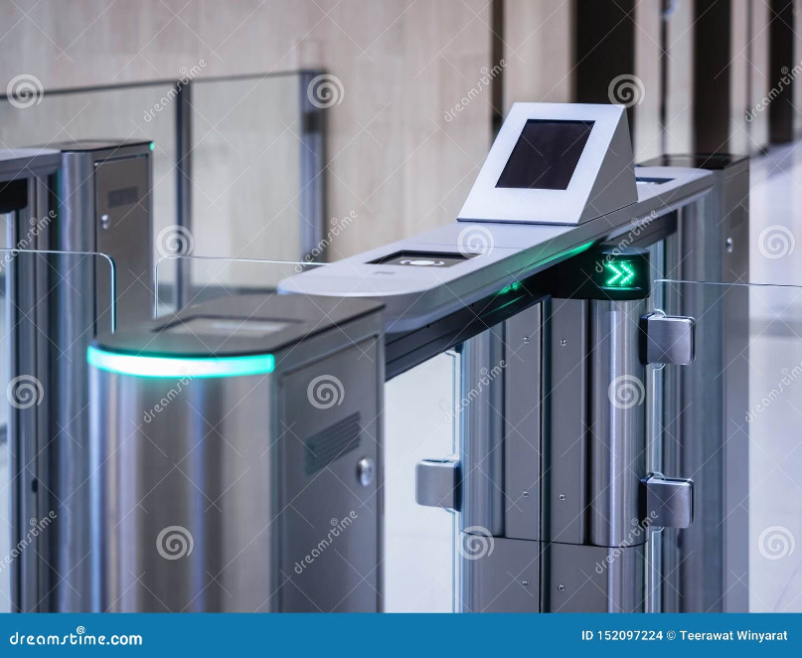
Main System Flow
User Interaction
System presents a main menu with options:
Login as administrator
Login as resident
Load/save data from/to JSON files
Exit
Login:
Administrator: Accesses options for managing the system (residents, vehicles, invoices, payments)
Resident: Accesses their personal data and can generate invoices.

Slide 12

Core Methods in PrjCondoManagement Class
1
Attributes
2
Methods
scanner: Used to read user input.
getIntInput(): Reads and validates user input, ensuring it is an integer.
admin: Instance of Administrator object, representing the administrator.
main(): Displays the main menu with options like login, save data, load data, or exit.
currentResident: Maintains the current resident's session.

Slide 13
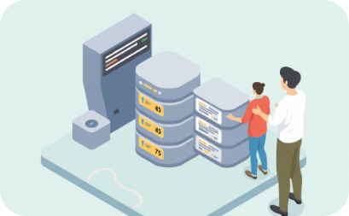
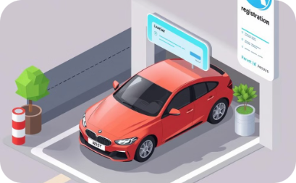
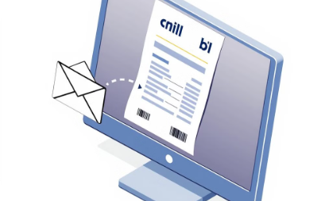

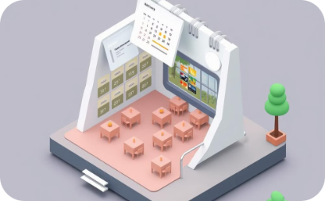
Administrator Menu
Manage Residents
Manage Vehicles
Generate Utility Bills
Process Payments
Add, remove, and view resident details.
Add and manage vehicle registrations.
Create and manage invoices.
Record and track resident payments.
Manage Area Reservations
Control reservations of common areas.

Slide 14

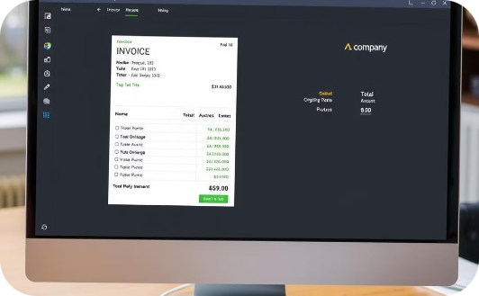
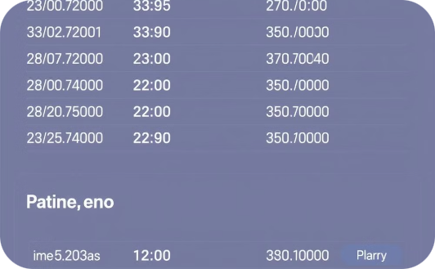
Resident Menu
View Personal Information
Generate Utility Bills
View Bills and Payments
Check personal details like name, phone, etc.
Residents can generate bills for services used.
See generated bills and payment history.

Slide 15



File Management (Data Persistence)
Saving Data
Loading Data
Data Security
Securely store project information in a persistent format.
Retrieve data quickly and efficiently.
Protect sensitive information with robust security measures.

Slide 16
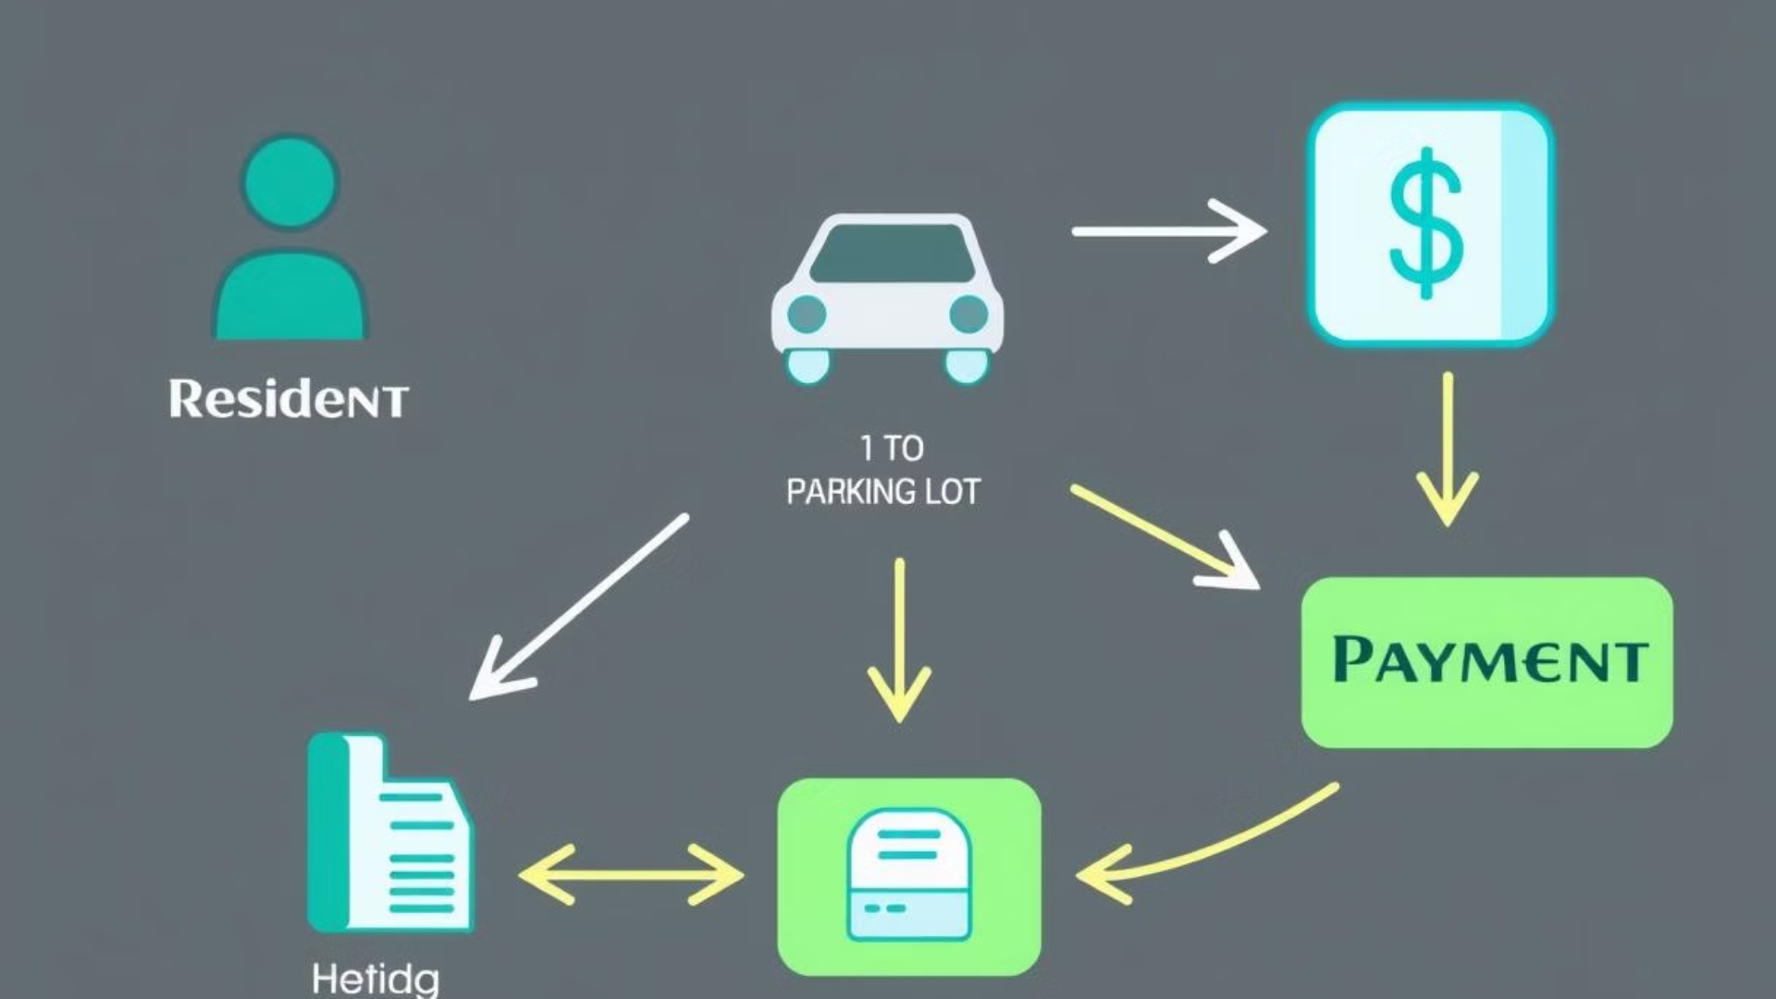





Class Relationships: Connecting the Dots
Resident
A Resident can have multiple associated Vehicles and UtilityBills.
Vehicle
A Vehicle is associated with a specific Resident and can be assigned to a ParkingLot space.
ParkingLot
A ParkingLot space can be occupied by a Vehicle associated with a specific Resident.
UtilityBill
A UtilityBill is associated with a Resident and tracks payments made.
Payment
A Payment is linked to a specific UtilityBill, allowing tracking of bill payments and reconciliation.

Slide 17
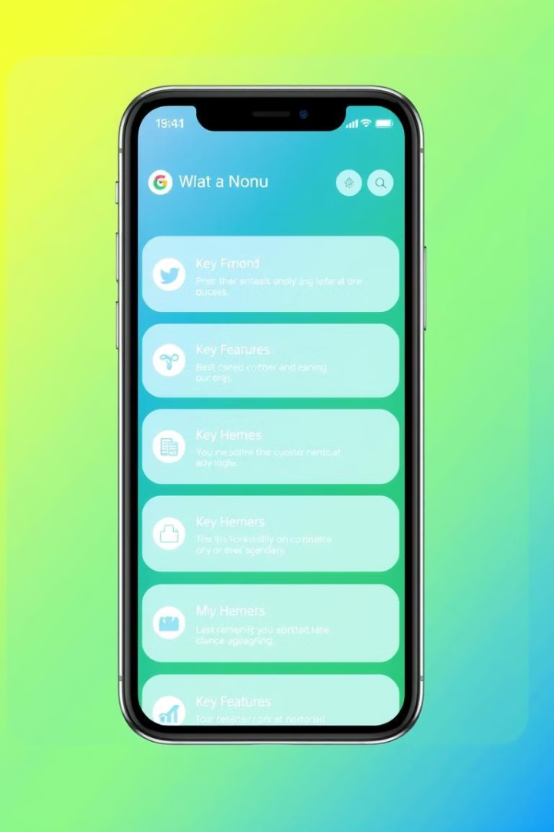
System Functionalities: Empowering Management
1
Authentication
2
Resident Management
The system provides secure login for both residents and administrators, ensuring access control and data security.
Administrators can easily add, remove, or modify resident details, including personal information, vehicle registrations, and billing data.
3
Vehicle Management
4
Billing and Payments
Administrators can assign and remove vehicles from resident accounts, manage parking lot assignments, and track vehicle access records.
The system generates utility bills automatically and allows residents to make payments, track payment history, and view invoice details.

Slide 18
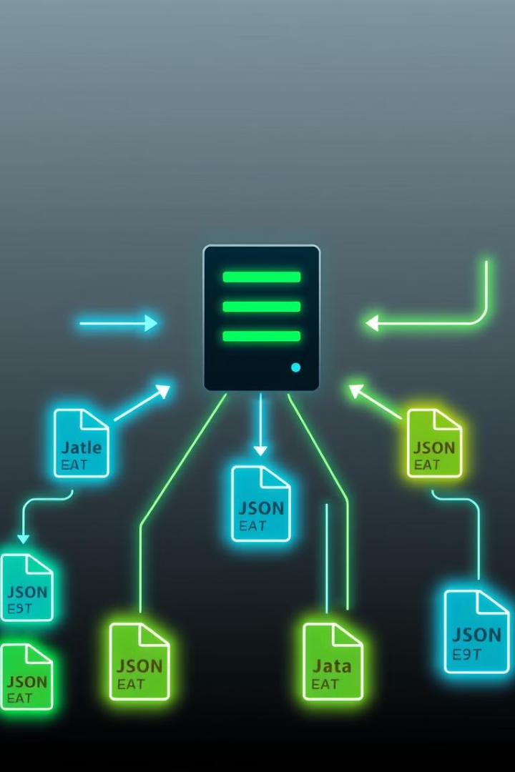
JSON File Management: Data Persistence and Retrieval
1
Data Serialization
When data is saved, the system serializes entity data into JSON format, which is then written to individual files. This ensures data consistency and ease of storage.
2
Data Deserialization
Upon system startup, the FileManager class reads the JSON files for each entity and deserializes the data, reconstructing the objects in memory. This allows for fast data loading.

Slide 19

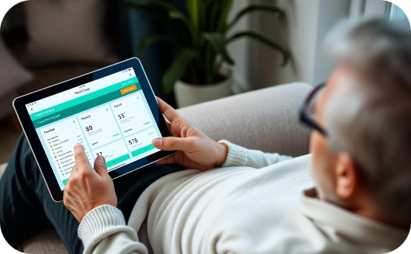
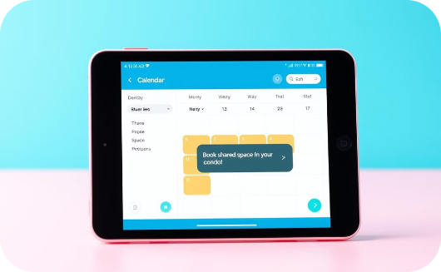
User Interaction
Administrator
Resident
Reservations
Administrators gain access to a comprehensive menu for managing residents, vehicles, bills, payments, parking, and reservations.
Residents can view their personal information, generate utility bills, track payment history, and make payments.
Residents can easily reserve common areas for events or meetings.

Slide 20
Future Enhancements: Expanding Capabilities
Integration
1
Integrate with external services (payment gateways, messaging, access control).
2
Advanced Reporting
Enhance reporting for detailed analytics and insights.
User Interface
3
Develop a more advanced and intuitive user interface.
4
Mobile App
Create a mobile app for convenient resident access.
AI Features
5
Explore AI for automated billing, predictive maintenance, and fraud detection.

